Slide 1
The Mindful Leader™
The Inside Work That Will Rock Your Outside World

Slide 2
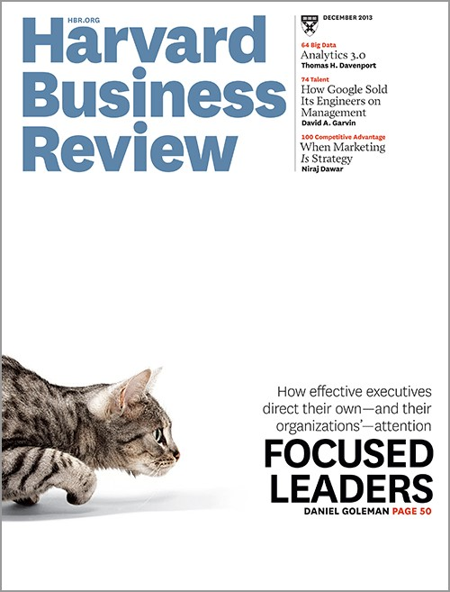
Mindfulness should no longer be considered a ‘nice to have’ for executives. It’s a ‘must have.’
~Harvard Business Review

Slide 4
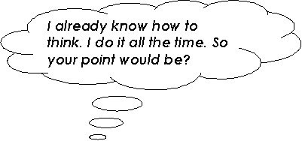
The Chatter Boxer™
We have 60,000 thoughts a day
95% of them were the same ones we had yesterday
71% of them are negative
*Chopra Institute

Slide 5
Change in Others…
Starts with a change in you

Slide 6
Meditation Will Make You…
A Better Leader!
Improved self management and energy
Greater productivity, creativity, and focus
Higher level of self awareness
…Happiness!
* Forbes Magazine

Slide 8
Multitasking Fallacy
‘Workers involved in multi-tasking experienced a sharper drop in IQ than if they had been smoking marijuana or had stayed up all night.’
*Researchers at the University of London’s Institute of Psychiatry

Slide 9
10 Minute Magic
Consistency is the key
Be comfortable – sit on floor, or a chair. Think about a “dignified” posture
Set a 10 minute timer on your phone
Observe your thoughts, without judgment, like they are passing by on a cloud

Slide 10
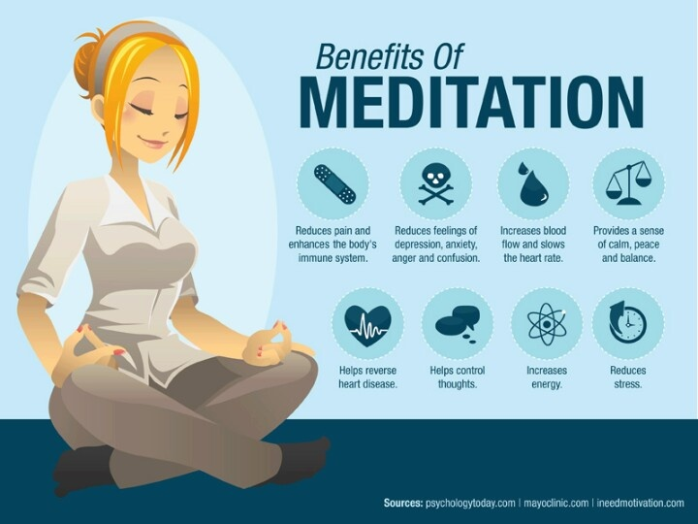

Slide 11
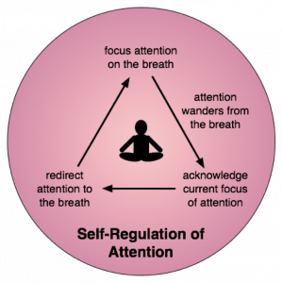

Slide 12
The 3 C’s of Mindful Leadership
Communication
Compassion
Coaching

Slide 13
Mindful Moments
Take a 10 second Mindful Breath and then ask…
What am I doing?
How may I serve?
What am I grateful for?

Slide 14
A Mindful Leader Asks…
“How may I serve?”

Slide 15
Appreciate What You Have
Taking time to contemplate what you are grateful for reduces the stress hormone cortisol by 23%
*Research from University of California , Davis

Slide 16
Build Mindful Momentum
Commit 10 minutes a day to your practice
Use Mindful Moments
Find a ‘Mindful Partner’
Communicate with compassion
Seek to coach and serve others

